Slide 1
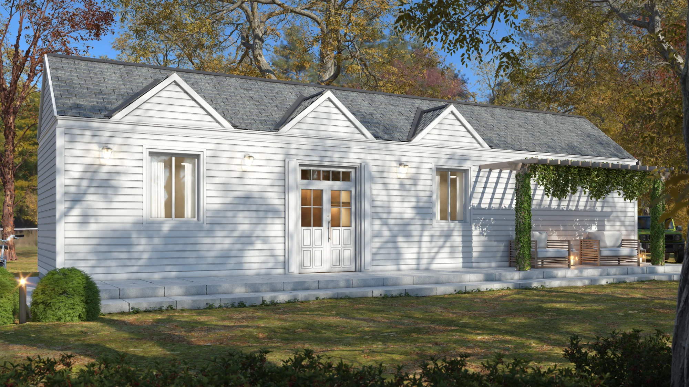
S E E D I N V E S T M E N T
MassDwell
Where Life Fits
AI-powered modular ADUs built for the future of
affordable housing.
Needham, MA

Slide 2
T H E P R O B L E M
America's Housing Crisis
🏠
💰
👷
3.8M
52%
40%
Unit Shortage
Cost-Burdened
Labor Shortage
National housing deficit creating
Construction industry facing critical
unprecedented demand for new
More than half of renters spending
skilled labor deficit, slowing traditional
construction solutions.
over 30% of income on housing costs.
building.

Slide 3
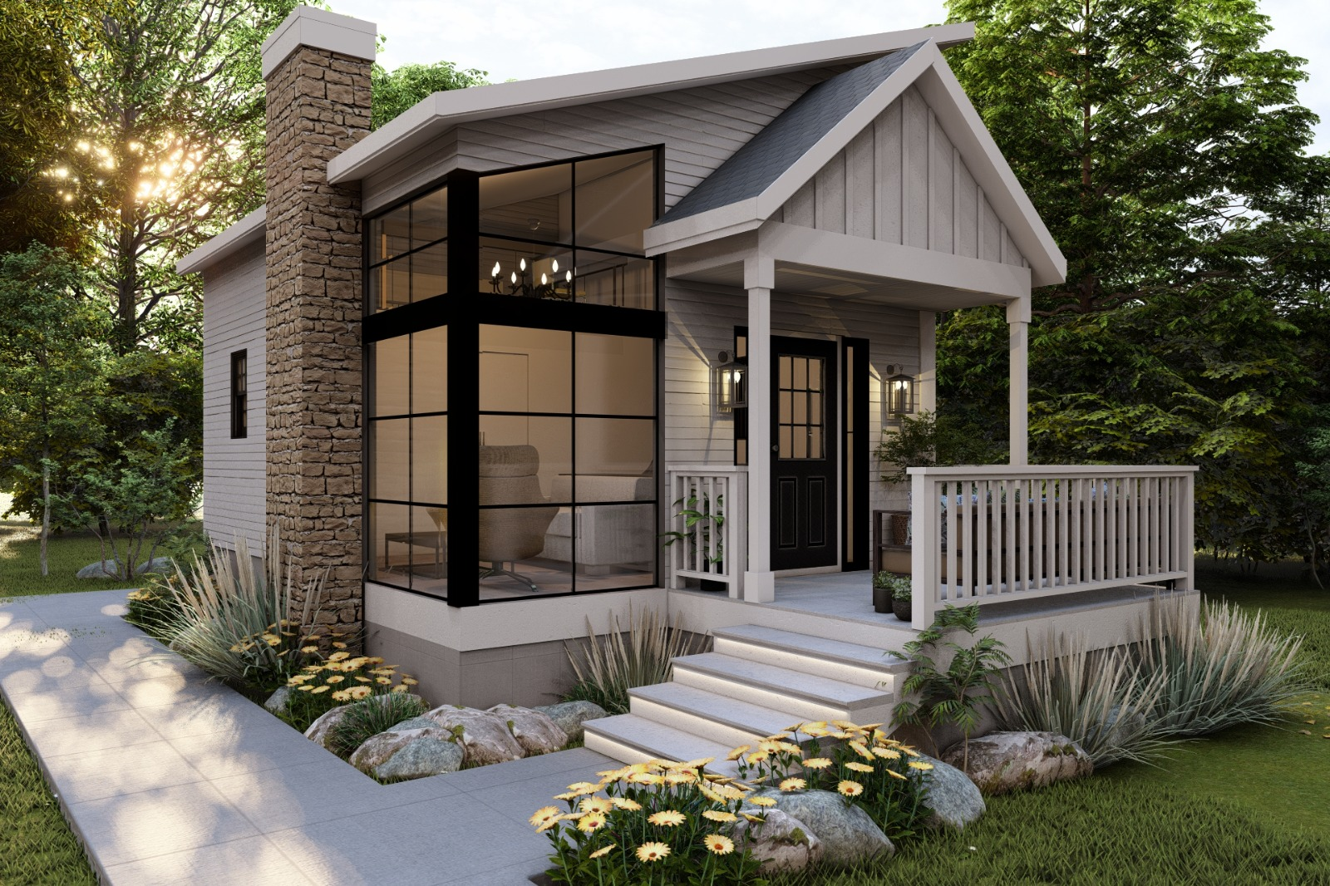
T H E S O L U T I O N
Modular ADUs,
Reimagined
MassDwell combines factory precision with AI-driven design
to deliver premium accessory dwelling units—faster,
smarter, and built to last.
🏭
Factory-built for speed and consistency
🤖
AI-optimized designs from natural language
🌱
Sustainable, net-zero ready construction

Slide 4
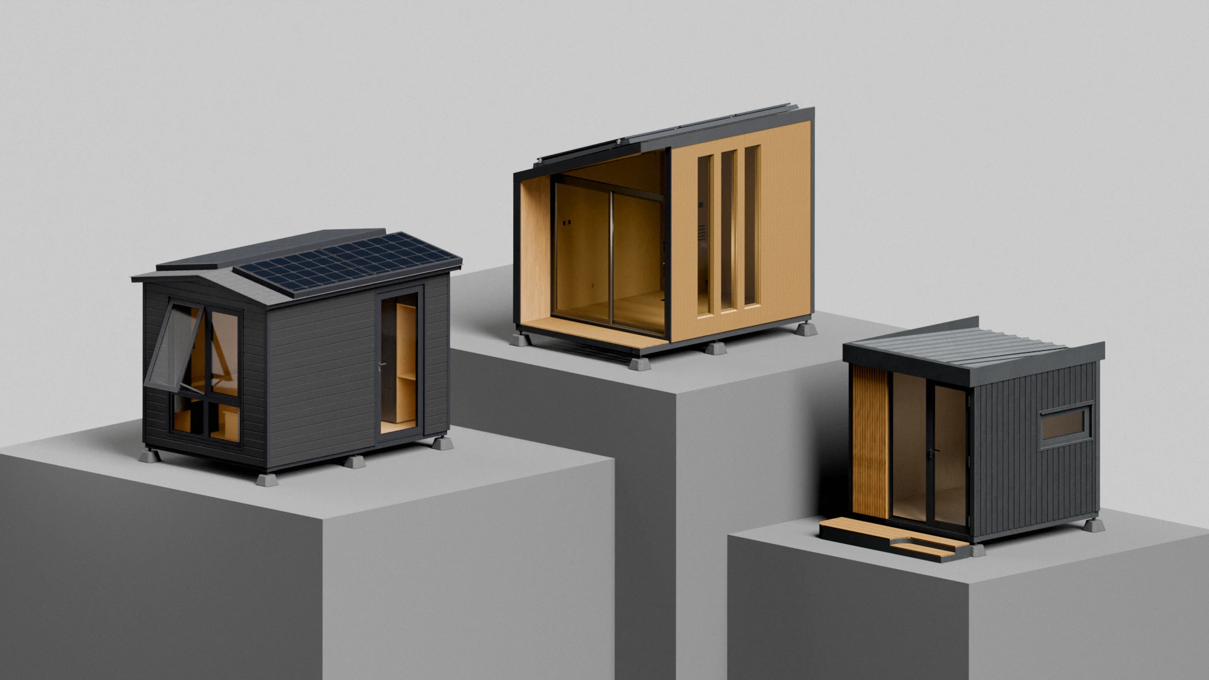
P R O D U C T V I S I O N
Infinite Designs.
One Platform.
AI generates fully bespoke floor plans from
natural language. No templates. No
constraints. Just your vision, built.

Slide 5
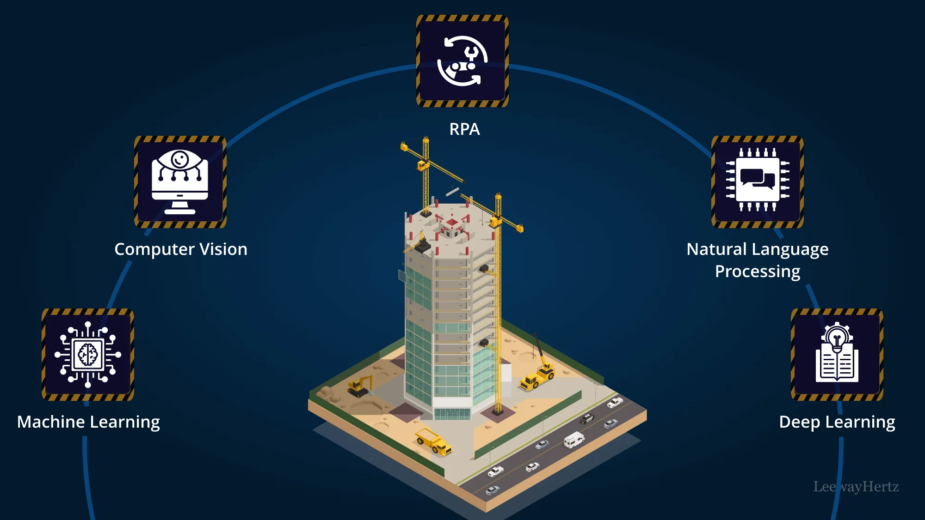
O U R T E C H N O L O G Y
AI + Robotics Integration
🤖
🏭
AI Platform
Robotics
Generative Design
Automated Assembly
AI creates optimized floor plans from natural
Precision manufacturing with robotic systems
language descriptions
Computer Vision QC
Predictive Analytics
Real-time quality control and defect detection
Demand forecasting and supply chain
optimization

Slide 6
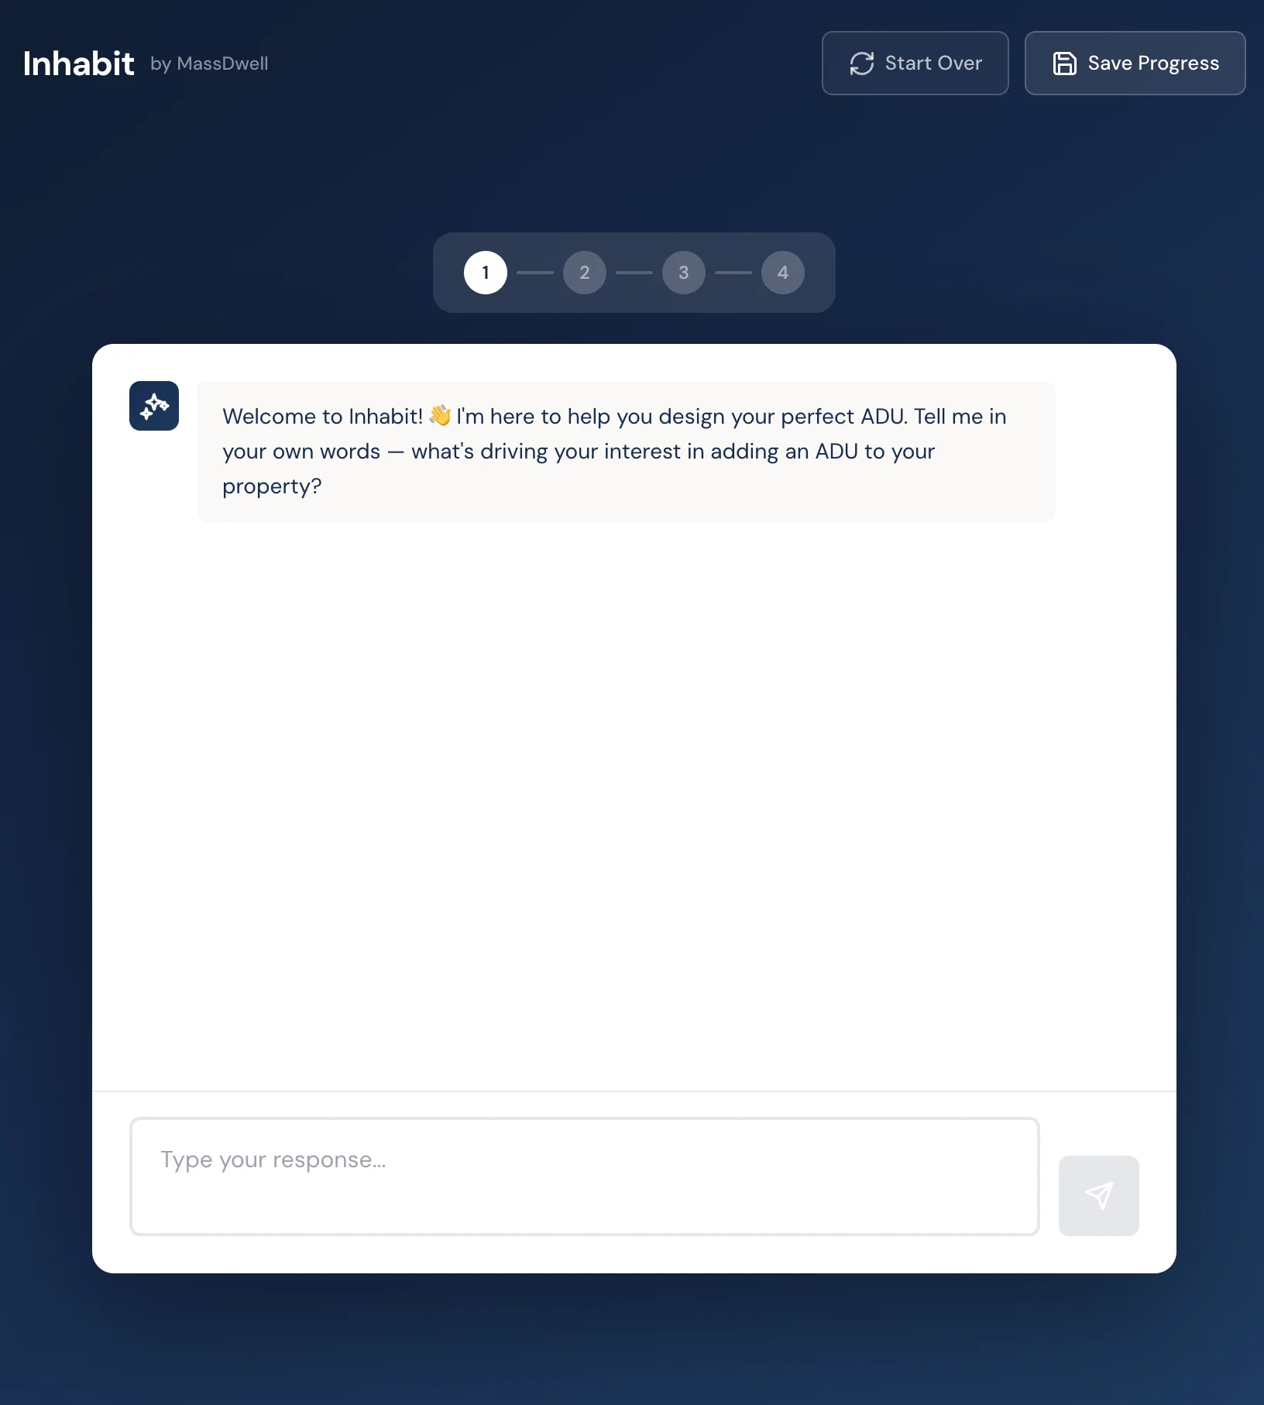
I N T R O D U C I N G
Inhabit
AI-powered design portal. Describe your
dream ADU in plain English and watch it
come to life.
💬
Natural language input
📐
Instant floor plans
✓
Auto zoning check
🏭
Direct to factory

Slide 7
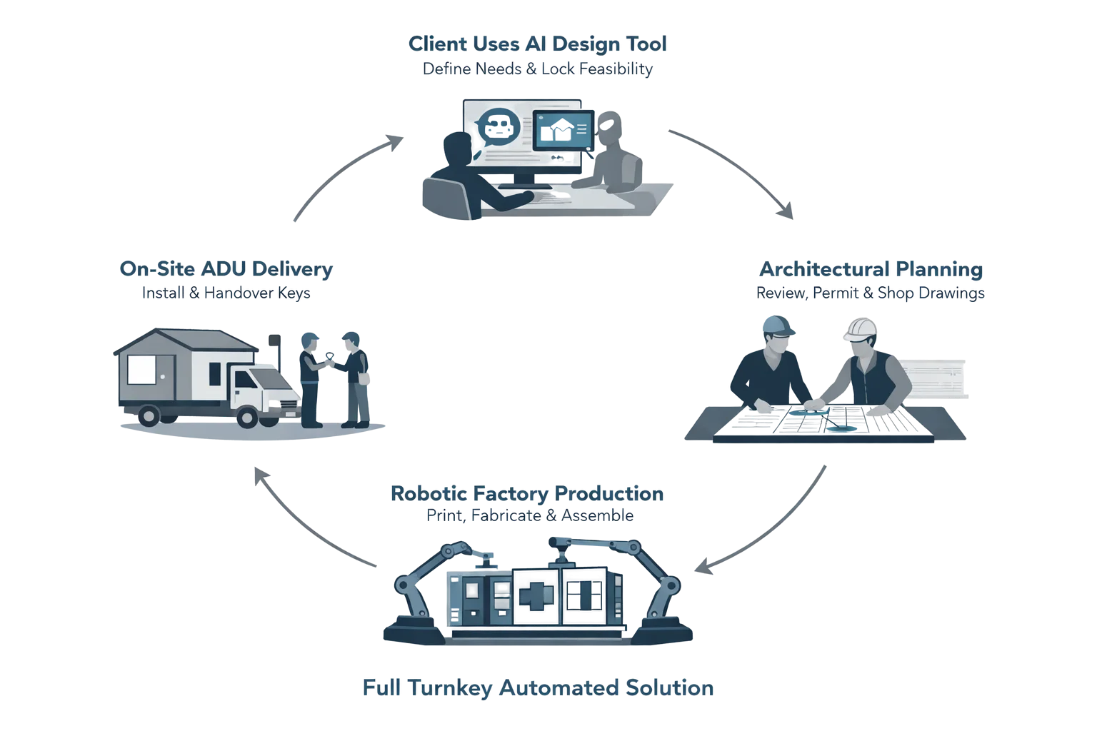

Slide 8
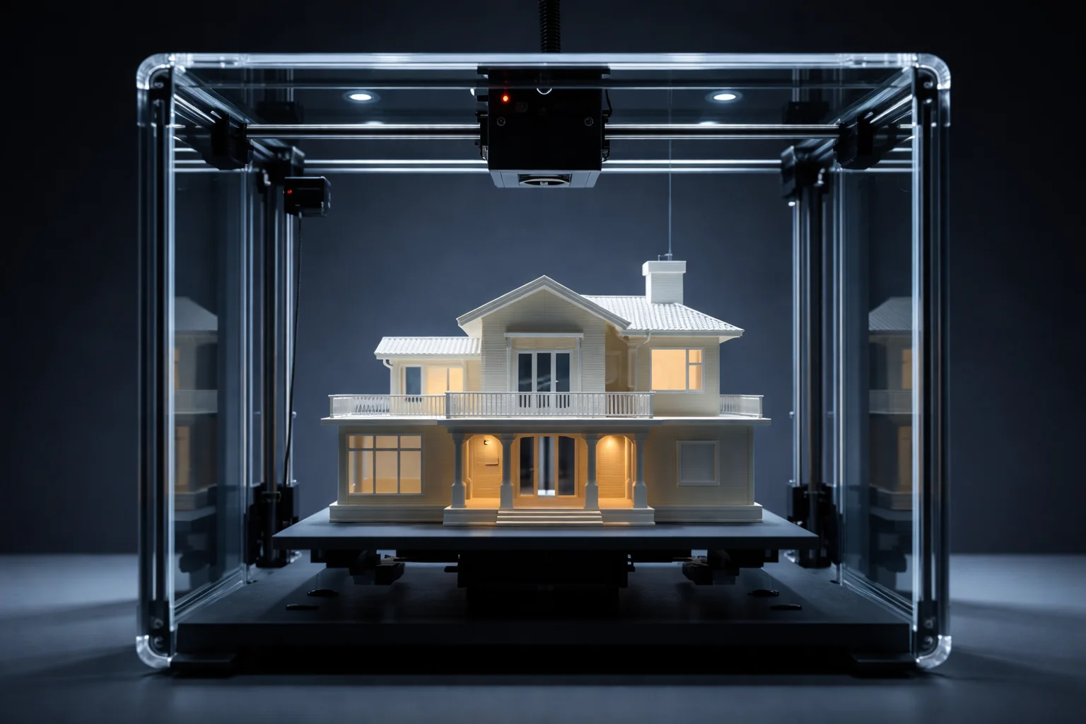
M A N U FA C T U R I N G E D G E
Cold Formed Steel:
Sub-Millimeter Precision
Robotic CFS fabrication achieves tolerances impossible with
traditional construction. Every component manufactured to exact
spec. Zero on-site rework.
±0.5mm
40%
Zero
Tolerance
Faster
Rework

Slide 9
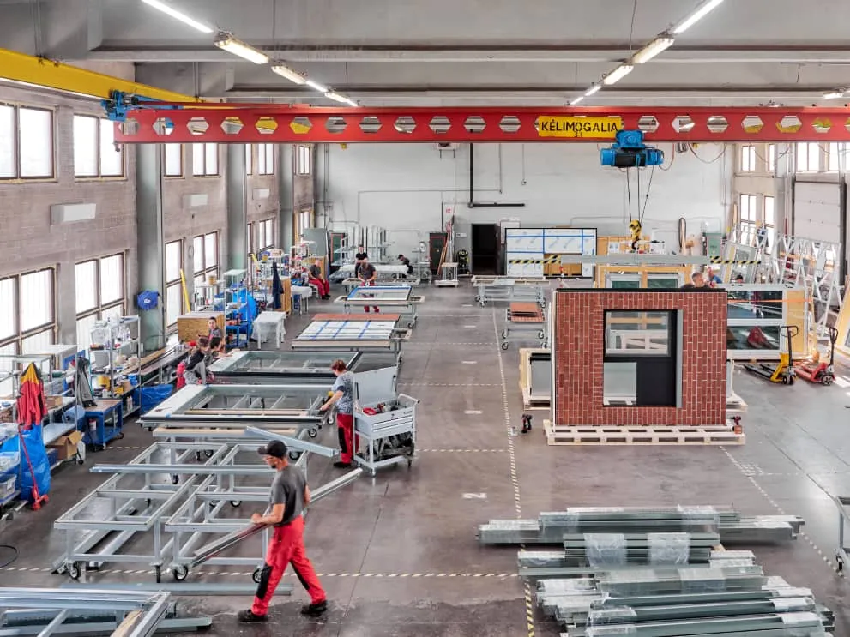
M A N U FA C T U R I N G S T R AT E G Y
Factory Roadmap
Interim Factory Launch
2026
25,000 sqft Rhode Island facility. Produce 5-6 prototype units while refining
operations.
Seed Funding
2026
$5M raise to fund flagship factory, AI platform, and team expansion.
Flagship Factory
2028+
100,000+ sqft fully automated facility. Full robotics, 100+ units/year capacity.

Slide 10
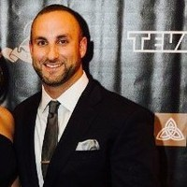
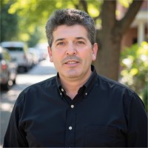

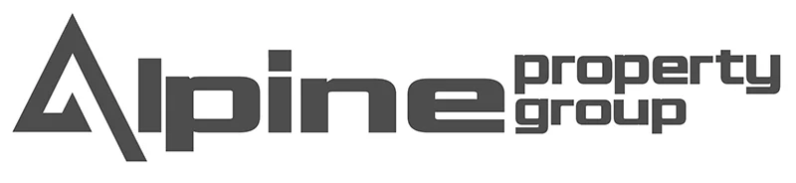
L E A D E R S H I P
The Team Behind MassDwell
Steve Vettori
📐
In-House Design Team
Founder & CEO
Needham, MA
Our architectural team handles every aspect of ADU design and permitting, ensuring seamless project execution
from concept to approval.
Carlos Ferreira
Founder & CTO
Newton, MA
✓
Custom floor plans tailored to lot constraints
✓
Full permit documentation & submissions
STRATEGIC PARTNERSHIP
✓
3D visualization for customer approval
🏗
In-House Site Work Team
Dedicated crews manage all on-site preparation and installation, maintaining quality control throughout the
×
construction process.
✓
Foundation & utility infrastructure
✓
Module delivery & crane installation
Steel engineering expertise meets property development experience.
✓
Final connections & finishing

Slide 11
M A R K E T A N A LY S I S
A Massive
Housing Affordability Crisis
🏠
Opportunity
ADUs add $100K+ property value with rental income
potential
📋
Regulatory Tailwinds
$47B
MA and other states rapidly easing ADU zoning rules
👨‍👩‍👧
Multigenerational Demand
Aging parents, adult children, remote work driving demand
Global ADU Market by 2035
🏭
Modular Construction Growth
40% labor reductions driving industry shift to factory
9.19%
CAGR

Slide 12
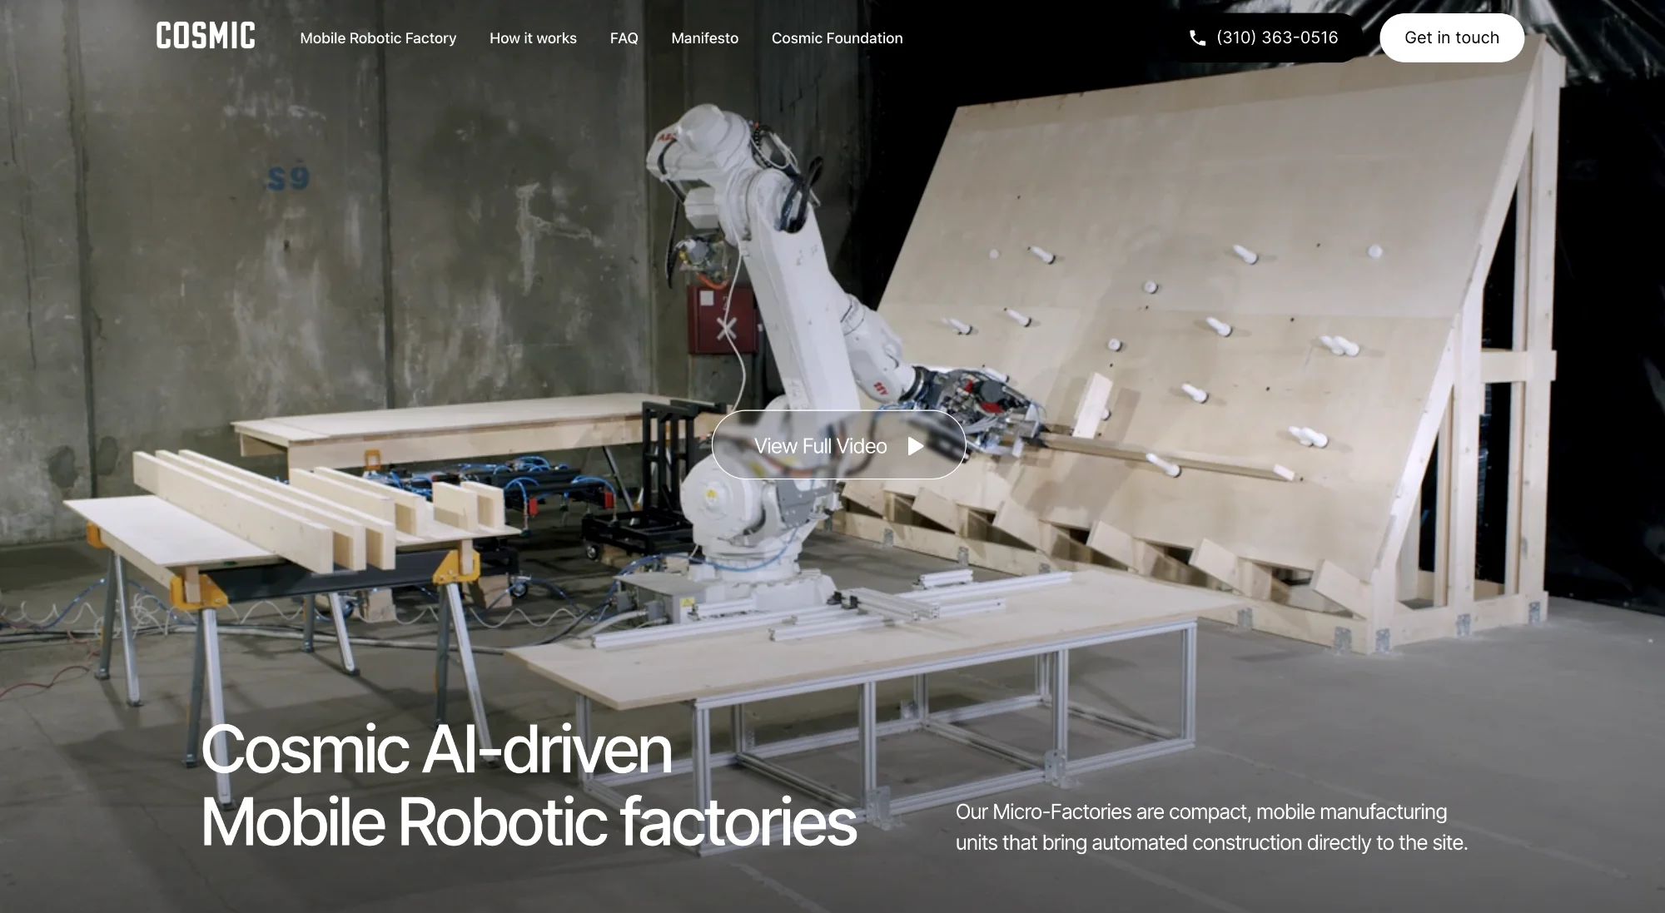

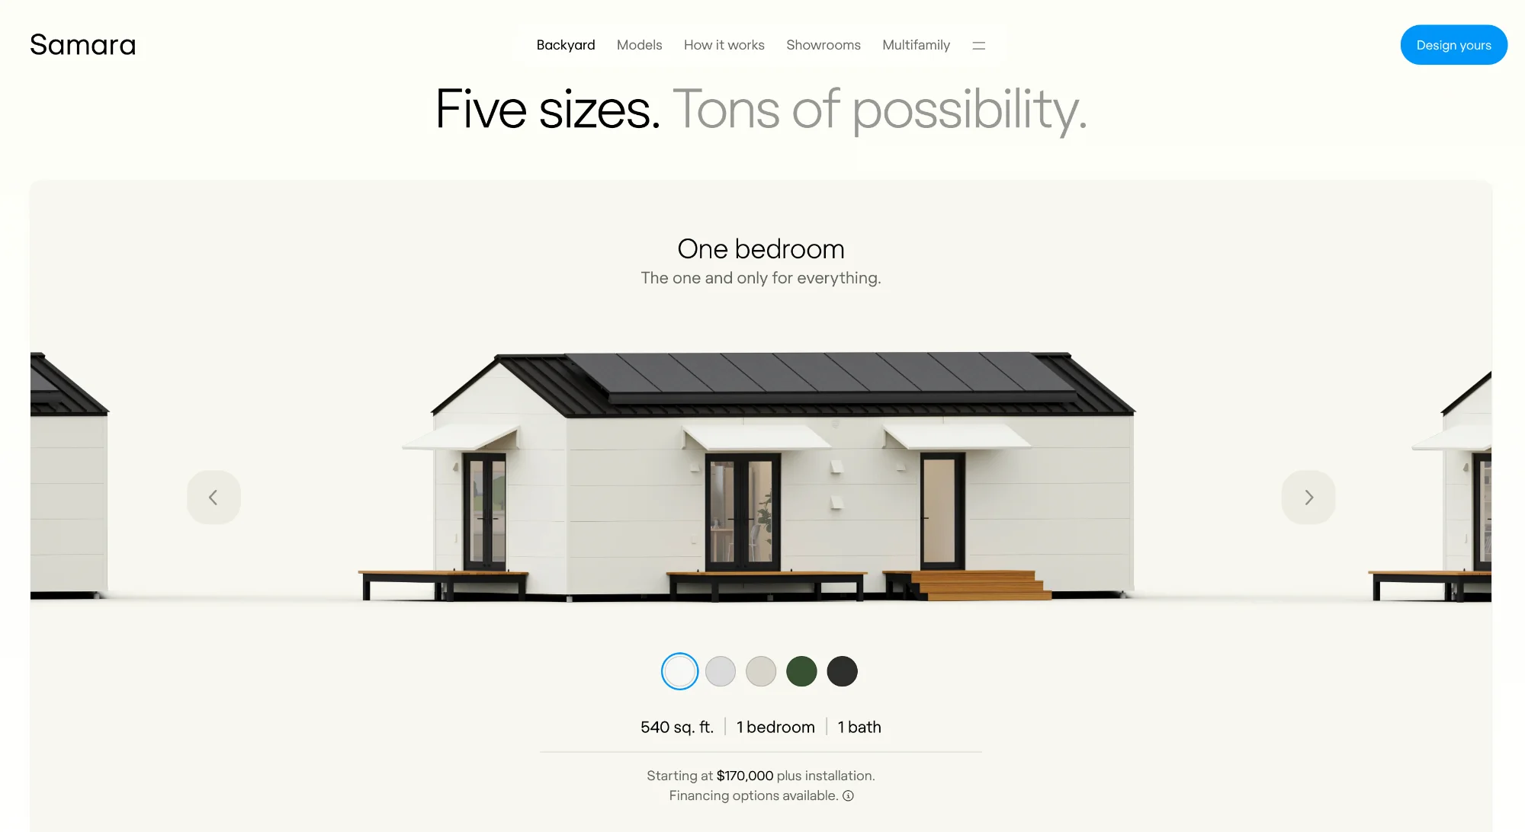
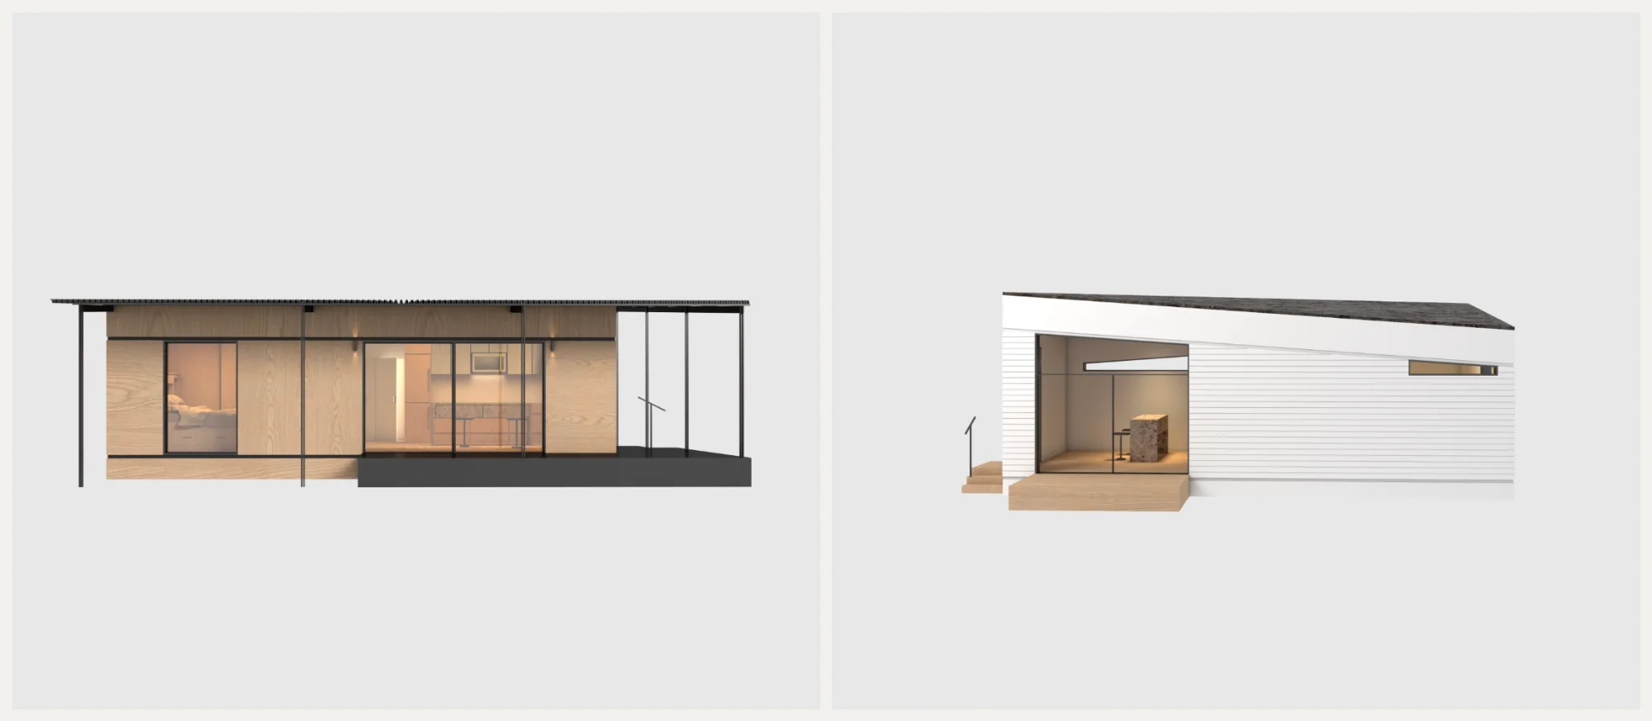
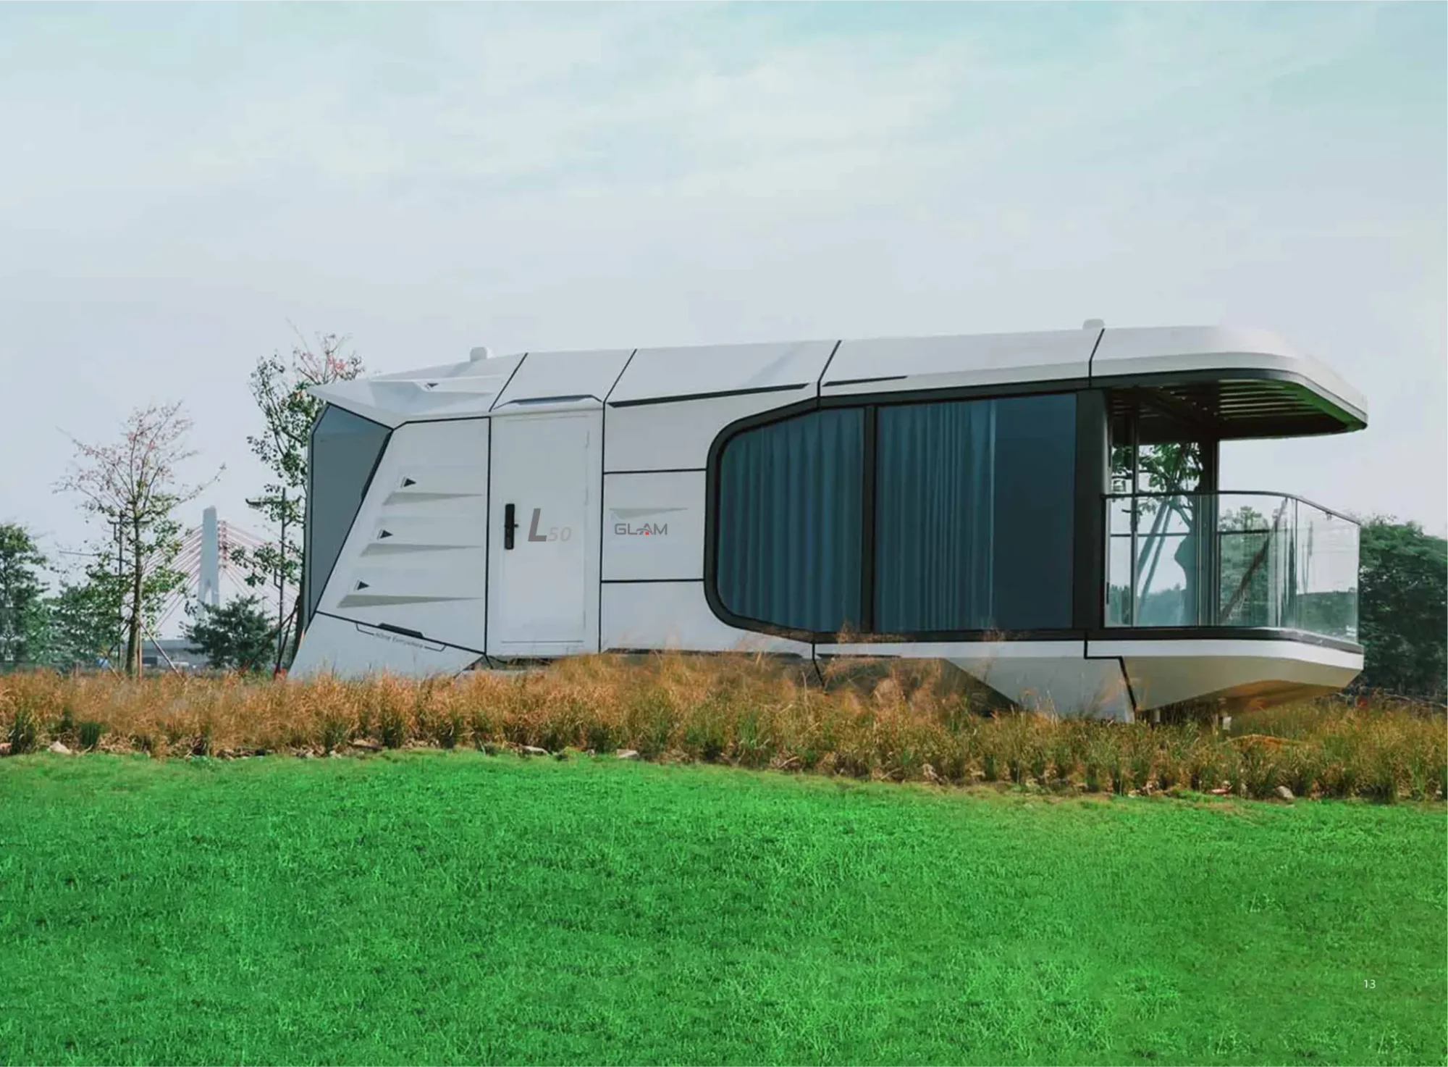
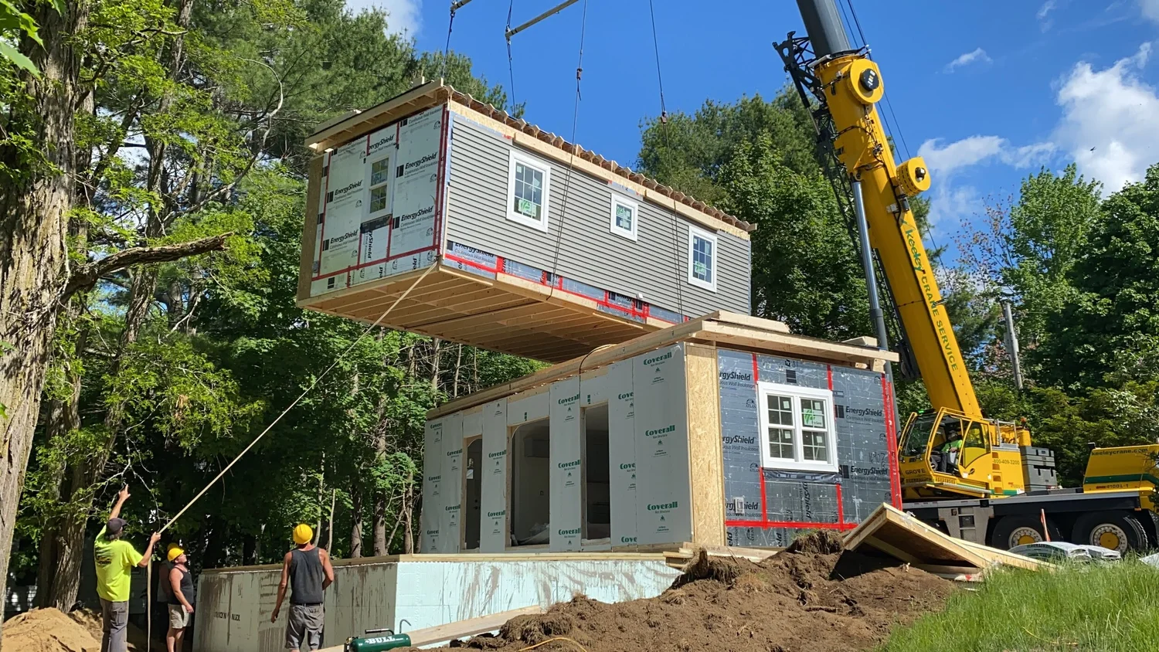
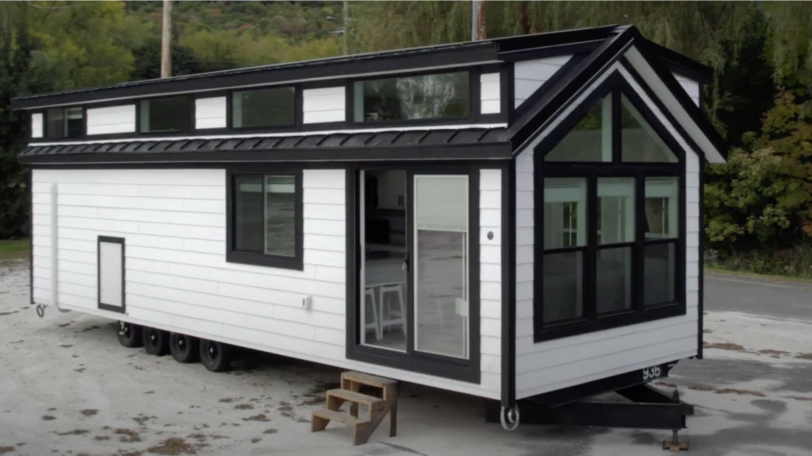
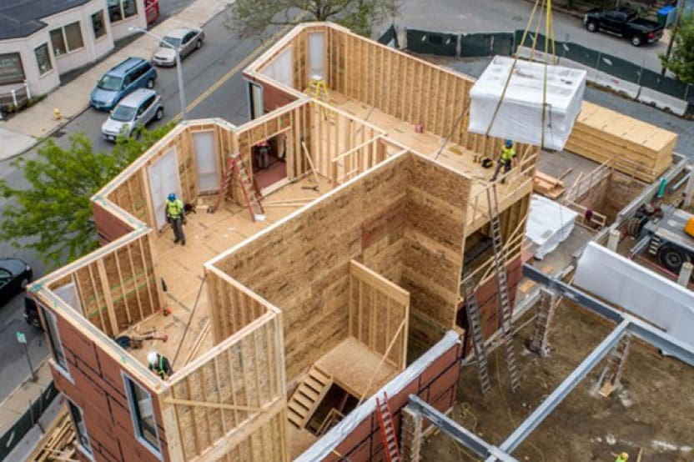
M A R K E T A N A LY S I S
Competitive Landscape
West Coast Innovators
Emerging Players
Northeast Traditional
3,000+ miles away
Limited ADU focus
No innovation
Cosmic Buildings
ROBOTICS
xHomes.ai
NY
Backyard ADUs
6-7 MO
Mobile robotic factories, SoCal
Robotics but weak ADU spec
Outsourced, long builds
Reframe Systems
FACTORY
Glamni / Imports
CHINA
LB Modular
LEGACY
Large-scale modular, CA
Doesn't fit US neighborhoods
Full homes only, dated
Samara
TEMPLATE
BB Tiny Houses
MANUAL
5 fixed models, template-based
Non-factory tiny homes
Dvele
HIGH-TECH
Tektoniks
PANELS
Premium prefab ADUs
Prefab walls, crane assembly
Leading innovation but logistics barrier to Northeast
Closest tech players lack specialization
Local vendors use outdated methods

Slide 13
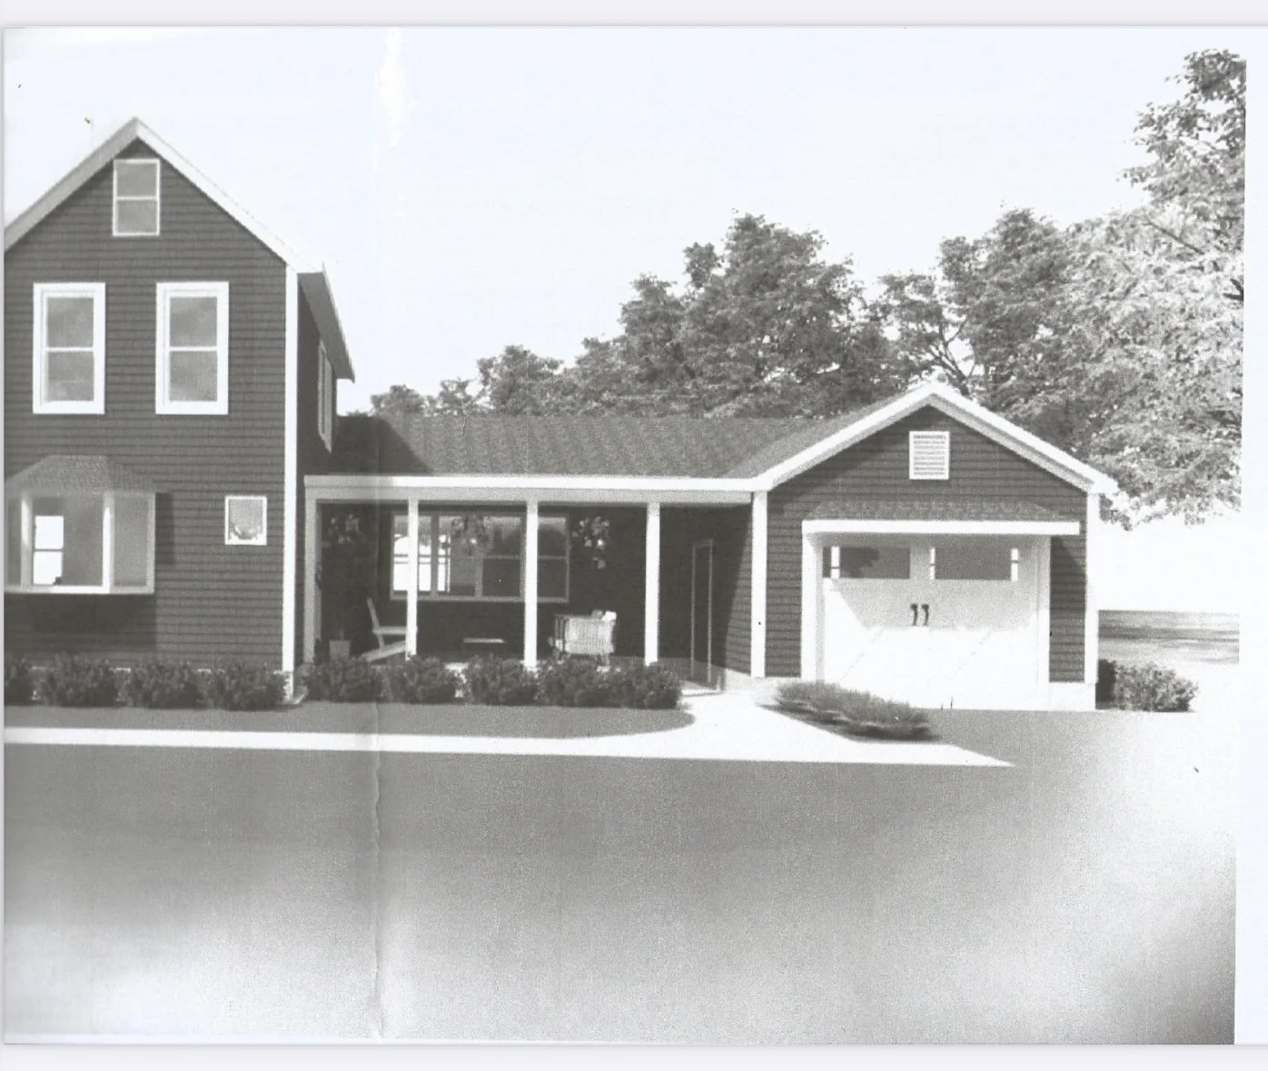
C O M P E T I T I V E A N A LY S I S
Northeast Today: No Innovation
CURRENT LOCAL VENDORS
THE OPPORTUNITY
First AI-driven modular
manufacturer in the Northeast
⚡
1 month production vs 6-7 months from local
competitors—we control our supply chain
🤖
Robotic precision that no MA vendor offers—sub-
millimeter tolerances
Backyard ADUs
LB Modular
6-7 month build time
Dated website & process
🎨
AI-powered customization vs fixed templates or stick-
built limitations
BB Tiny Houses
Tektoniks
→ Clear path to regional market leadership
Too small, non-factory
Panels only, crane assembly

Slide 14

F I N A N C I A L S
Growth Trajectory
Metric
2026
2027
2028
2029
35-45%
Units Sold
15
40
100
200
Target Gross Margin
Revenue
$3M
$8M
$20M
$50M
Gross Margin
25%
30%
35%
45%
Late 2027
EBITDA
-$500K
$500K
$4M
$12M
Break-Even Target
5x+
ROI Potential

Slide 15

Y O U R U P S I D E
T H E A S K
SAFE Note
Series A at $30M
→
2×
$15M Cap
~5× projected 2026 revenue
Series A at $45M
→
3×
📄
Instrument
Post-Money SAFE (YC Standard)
Series A at $75M
→
5×
💰
Raising
$1M – $5M
🎯
Minimum Investment
$25,000
Early believers get significant advantage with the $15M cap. Standard YC docs
—close in days, not months.

Slide 16
U S E O F F U N D S
Where Your
Capital Goes
Why SAFE?
⚡
Speed
Factory Operations & First Units
50%
Standard YC docs. Close in days, not months.
AI Platform Development (Inhabit)
25%
🎯
Focus
Defer valuation until we have production data.
Team Expansion & Operations
25%
Alignment
🤝
No board seats or control terms. Execution focus.
2 0 2 6 M I L E S T O N E S
📈
Upside
$15M cap gives early believers significant advantage.
✓
Factory operational Q1
✓
15+ units delivered
✓
$3M+ revenue
✓
Path to Series A
"We're not asking you to value us. We're asking you to believe in
us."

Slide 17
Thank You
Where Life Fits
Steve Vettori, Founder & CEO
Carlos Ferreira, Founder & CTO
Needham, Massachusetts
massdwell.com

Slide 18
AI-Powered Operations
We don't just build with AI. We run with AI.
🤖
AI Voice Assistant
Qualifies leads 24/7, books follow-ups automatically
📊
Intelligent CRM
No lead goes 24+ hours without follow-up
📧
Automated Outreach
Email triage, drafting, and response scheduling
📈
Real-Time Analytics
Pipeline forecasting and market monitoring
Small team. Massive output. AI amplifies every role.

